Slide 1

Beginnings
Tom Bielicki, Mike Moran, Patricia Mckiever,
Emma Russo, Mary McGuinness, Emma Pettit

Slide 2
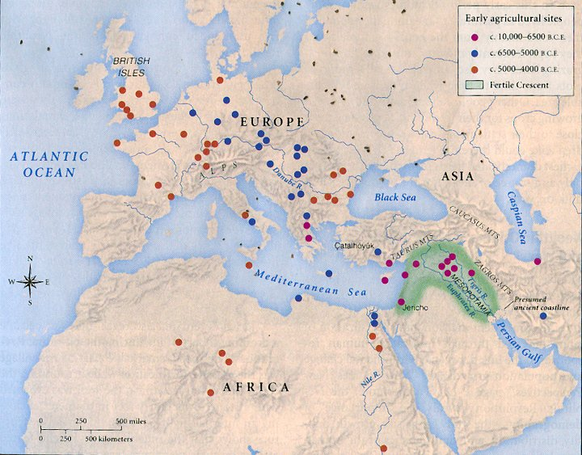
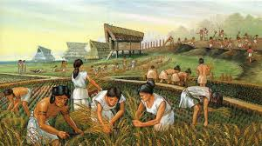
Agricultural Revolution

Slide 3
Neolithic Revolution 8000 B.C.E
The first agricultural revolution
Marked the transition from hunting and gathering to settled societies.
The ability to acquire food regularly gave humans greater control over their environment and made it possible to settle into permanent communities called Neolithic farming villages.

Slide 4
AP Theme:
This connects to AP World theme # 1: Interaction between humans and the environment
  Patterns of settlement and technology
  Revolution catalyzed the development of settled societies.
  The societies modified their natural environment using technologies proving the basis for densely populated settlements.

Slide 5
Historiographical Perspective
Long after agriculture became the basis of life for the majority, hunters and gathers and shifting cultivators held out in many areas of the globe.
Pastoralism evolved after the domestication of animals and competed with the agricultural based way of life.
A social differentiation. Human communities became differentiated by occupations.
The social and economic position of woman began to decline

Slide 6
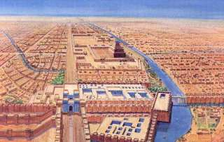
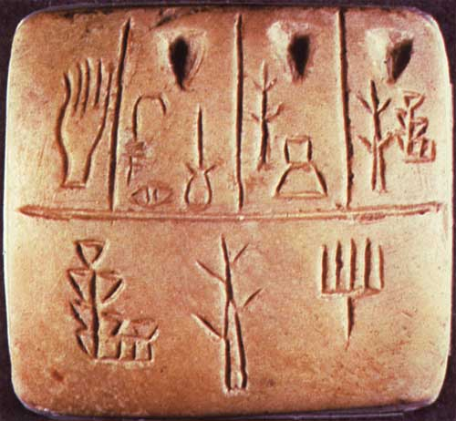
Bronze Age

Slide 7
Mesopotamia and the Brizatene Empire
1800 B.C.E
First major human civilization
Cities started forming with basic government
Culture, traditions, and beliefs were adopted
Basic language was invented

Slide 8
AP Theme:
AP Theme 2
Clashing of cultures
New religions
Flourishing in the arts
New advances in mathematics and sciences
AP Theme 3
The government was stratified and a new empire was built.

Slide 9
Historiographical Perspective
Society was built on the backs of slaves, and had few rights for women and lower classes.
Societies like Mesopotamia set up the foundation for later civilizations such the Roman Empire.
Mesopotamia was much more advanced than any settlements in Europe at this time.

Slide 10
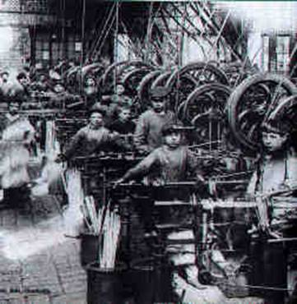
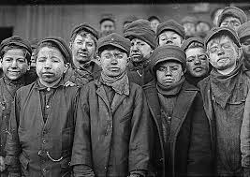
Steel Age

Slide 11
Industrial Revolution 1750-1850
Period in which mainly agrarian and rural societies in Europe and America became industrialized and urban.
Machines replaced human labor.
Als improved transportation, banking and communication.

Slide 12
AP Theme:
Relates to AP theme #2 development and interaction of cultures, specifically science and technology, at the time these machines replaced manual labor so they were hundreds of times more efficient than one person doing the task by hand.

Slide 13
Historiographical Perspective
For many people the Industrial Revolution meant unemployment. Replaced by machines that could do 10x the work they could for free, people found themselves without work. This also opened up more opportunity for advancement in other fields since the need for factory workers was greatly reduced.

Slide 14

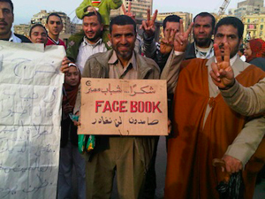
Information Revolution

Slide 15
Information Revolution 1950-PRESENT
Started with the invention of the computer chip
Dramatic changes of jobs using high levels of technology- service jobs
New technology provides more information faster and more efficiently
This new technology controls and connects the world- the internet
Changes socially, economically, politically, medically, and in culture

Slide 16
Arab Spring 2010-Present
A revolution driven by the Internet
Many young people used social media to promote their stance
Wanted democracy throughout the Middle East
These revolutions were spread and gained support with the aid of social media
“Technology Generation”- agency

Slide 17
AP Theme:
AP Theme 2- Development and interaction of cultures
-Science and Technology
AP Theme 3- State-building and forms of government
-Revolts and Revolutions
AP Theme 5- Development and transformation of social structures
-Social and economic classes

Slide 18
Historiographical Perspective
Created the Arab Spring Revolutions throughout the Middle East-agency
Advanced technology- medically, militarily, socially, economically, and politically
Connects the world through the internet
More service jobs than manufacturing jobs

Slide 19
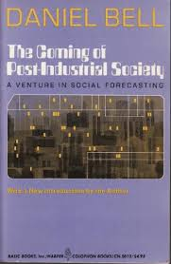

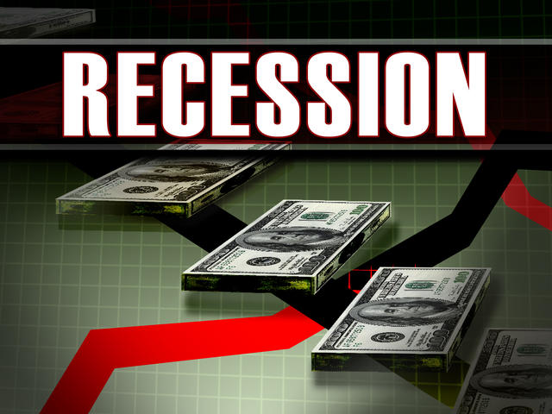
Post-Industrial Revolution

Slide 20
Postindustrial Societies 1974-Present
A postindustrial society is a society dominated by information, services, and high technology than the production of goods.
The term Post-Industrial came from a book named The Coming of Post-Industrial Society by Daniel Bell
The U.S. is the first country to have over half of its workforce employed in service industries; which include: government, research, education, health, sales, law, banking, and so on.
Postindustrial belies the fact that we don’t yet quite know what will follow the industrial society or the form it will take.

Slide 21
Recession 2005-Present
Recession is defined as: a period of an economic contraction, sometimes limited in scope or duration.
The U.S., France, Italy, and more European nations are currently in a state of recession.
Other countries have been in a state of depression including India for almost 200 years under British control, and in the U.S. during post-WWI.
During our current recession we acted differently than during our Great Depression in 1930 by mounting a swifter rescue effort.

Slide 22
AP Theme:
AP World Theme #2- Development and Interaction of Cultures
- Science and Technology
AP World Theme #4- Creation, Expansion, and Interaction of Economic Systems
- Labor Systems
- Industrialization

Slide 23
Historiographical Perspective
The Post Industrial Revolution has marked the age of service societies and the end of manufacturing, or production societies.
This has never been done or attempted before in human history.

Slide 24
Beginning of a New Era
The Domestication Revolution was the turning point from food-collecting to horticulture and raising plants and animals which gave civilizations more immediate and dependable food sources.
The Agricultural Revolution further enhanced domesticated societies with the invention of the plow. This time is also known as the “Dawn of Civilization” as the wheel, writing, and numbers were invented. This Era also brought a greater division in labor and society.

Slide 25
Beginning of a New Era
The Industrial Revolution replaced tools and manpower from the Agricultural Revolution with machines and steam power. Inequality for workers grew even more because people were either the rich owner of the factory or a poor worker.
The Information Revolution brought service jobs to takeover the jobs in manufacturing and agriculture. Computers and the knowledge that went along with them became an important part in our now information-driven society.
Postindustrial Societies are further examples of the effects of the Information Revolution. Societies are now focused primarily on service jobs.

Slide 26
Works Cited
Bell, Daniel. "He Said It First." The Economist. The Economist Newspaper, 13 Nov. 1999. Web. 14 Sept. 2014.
Bryant. “Pre-History Packet.” Manasquan High School, Manasquan. 14 September 2014. Lecture
Bryant. “Pre-History.” The Information Revolution. Manasquan High School, Manasquan. 14 September 2014. Lecture

Slide 27
Works Cited Continued
Bryant. "Pre-History." Neolithic Revolution. Manasquan
High School, Manasquan. 11 Sept. 2014. Lecture
Cowen, Tyler. "Lesson From Old India: When an Economy Just Doesn’t Get Better." The New York Times. The New York Times, 23 Aug. 2014.
"Time." Time. British Museum, n.d. Web. 12 Sept. 2014.

